Slide 1
APEXX Hosted Payment Page – Fields and Layout Options
May 2020

Slide 2
A Global Partner for Local Payments
Our vision is to be the payment industry's most merchant centric provider. Through our platform a merchant can connect via a simple API connection to the world's payment ecosystem, increasing conversion at lower cost and satisfying their entire payments needs

Slide 3
APEXX Hosted Payment Page
APEXX Global’s Hosted Payment Page allows merchants who do not wish to maintain PCI Level 1 compliance to compliantly capture card details during the checkout process. It is designed to be loaded into an iframe.
For technical details, please refer to the following sections of our API reference:
Customisation
iFrame
Redirect Return URL Parameters
HMAC Signature Calculation
©APEXX Fintech Limited - 10131902

Slide 4
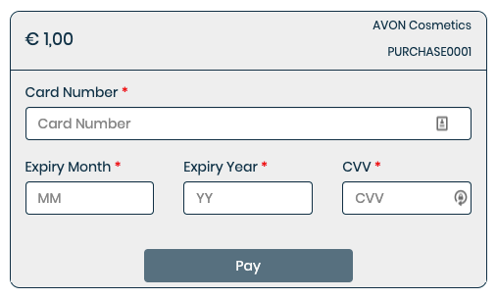
HPP Layout without Custom Fields and Custom Labels – with Order Summary
Amount, organisation name and merchant reference are shown when the show_order_summary attribute in the hostedPaymentPage API request is set to true or is not sent

Slide 5
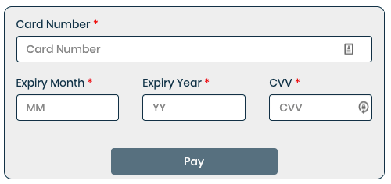
HPP Layout without Custom Fields and Custom Labels – without Order Summary
Amount, organisation name and merchant reference remain hidden when the show_order_summary attribute in the hostedPaymentPage API request is set to false

Slide 6
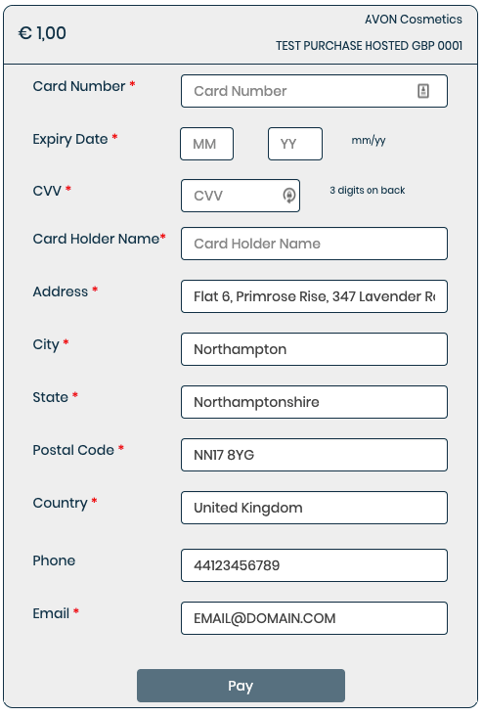

HPP Layout with Custom Fields, Custom Labels and Order Summary – Vertical Layout
Amount, organisation name and merchant reference are shown when the show_order_summary attribute in the hostedPaymentPage API request is set to true or is not sent
Including the show_custom_fields block enables the display of the card holder name and address fields.
The card holder name will always be mandatory when requested
The address can be optional or mandatory
Address data is prepopulated with values sent in the HPP request
The phone number is always optional
The email address is always mandatory
Toggle between horizontal and vertical layout

Slide 7
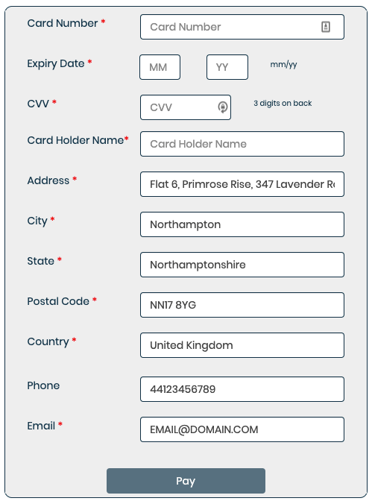

HPP Layout with Custom Fields and Custom Labels - no Order Summary – Vertical Layout
Amount, organisation name and merchant reference remain hidden when the show_order_summary attribute in the hostedPaymentPage API request is set to false
Including the show_custom_labels block allows merchants to add their own custom labels to the expiry date and CVV fields.
Custom labels will only be displayed in the vertical layout.

Slide 8
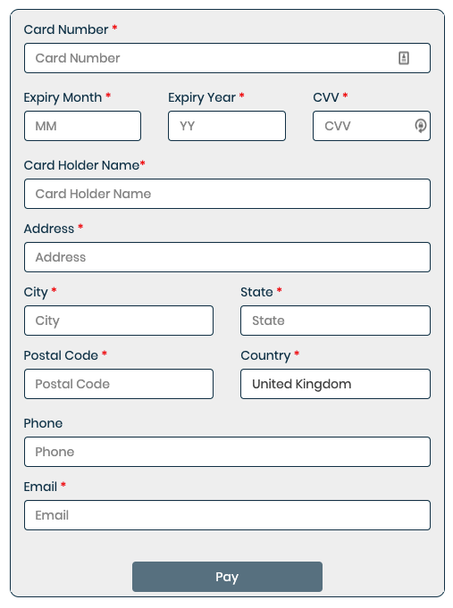
HPP Layout with Custom Fields and Custom Labels - no Order Summary – Horizontal Layout
Amount, organisation name and merchant reference remain hidden when the show_order_summary attribute in the hostedPaymentPage API request is set to false
Values sent in the show_custom_labels block are only displayed in the vertical layout.
Including the show_custom_fields block enables the display of the card holder name and address fields.
Address data fields will be blank if no address data is sent in the HPP request

Slide 9
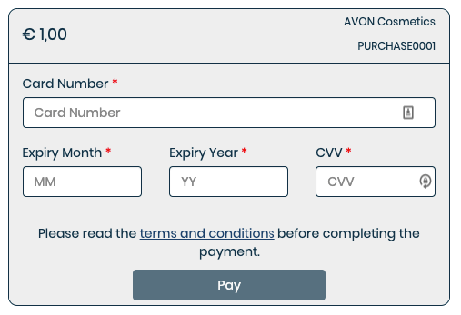
HPP Layout (any option) - Terms and Conditions
Optionally, a link to the terms and conditions on the merchant’s website can be displayed above the Pay button. This is configured by APEXX at organisation level and not controlled by the data in the payment request

Slide 10
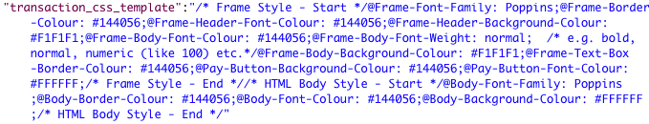
HPP Styling options
To allow merchants to maintain a look and feel to the payment page that is consistent with the rest of their website, APEXX supports customisation of certain aspects of the hosted payment page form. The elements that are subject to customisation are defined on the right.
By default, these are stored as part of the merchant configuration data in the APEXX gateway.
Merchants who need to meet multiple different brand standards can alternatively send the transaction_css_template attribute in the HPP request to dynamically control the styling of the page displayed.
/* Frame Style - Start */
@Frame-Font-Family: Poppins;
@Frame-Border-Colour: #144056;
@Frame-Header-Font-Colour: #144056;
@Frame-Header-Background-Colour: #F1F1F1;
@Frame-Body-Font-Colour: #144056;
@Frame-Body-Font-Weight: normal; /* e.g. bold, normal, numeric (like 100) etc.*/
@Frame-Body-Background-Colour: #F1F1F1;
@Frame-Text-Box-Border-Colour: #144056;
@Pay-Button-Background-Colour: #144056;
@Pay-Button-Font-Colour: #FFFFFF; /* Frame Style - End */ /* HTML Body Style - Start */
@Body-Font-Family: Poppins; @Body-Border-Colour: #144056; @Body-Font-Colour: #144056;
@Body-Background-Colour: #FFFFFF;
/* HTML Body Style - End */

Slide 11
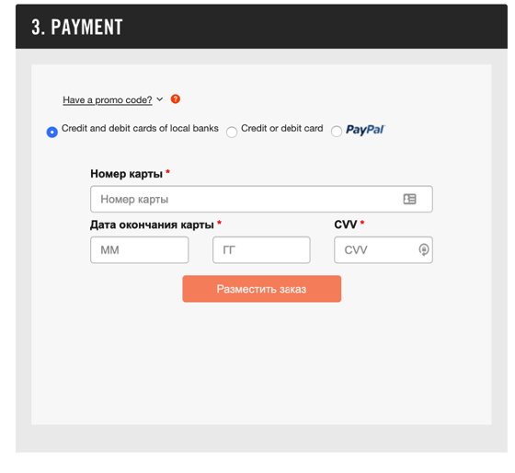
Example of a non-English hosted payment form – Nike Russia
Language options are controlled using the locale attribute in the Hosted Payment Page API request.

Slide 12
Any questions?
Head Office
APEXX Global, 5a Underwood Street
London, England, N1 7LY
United Kingdom
Enquiries
123@apexx.global
www.apexx.global

